Slide 1
Temporal dynamics
Max Plank Institute

Slide 2
What drives changes in ecosystem processes over time?

Slide 3
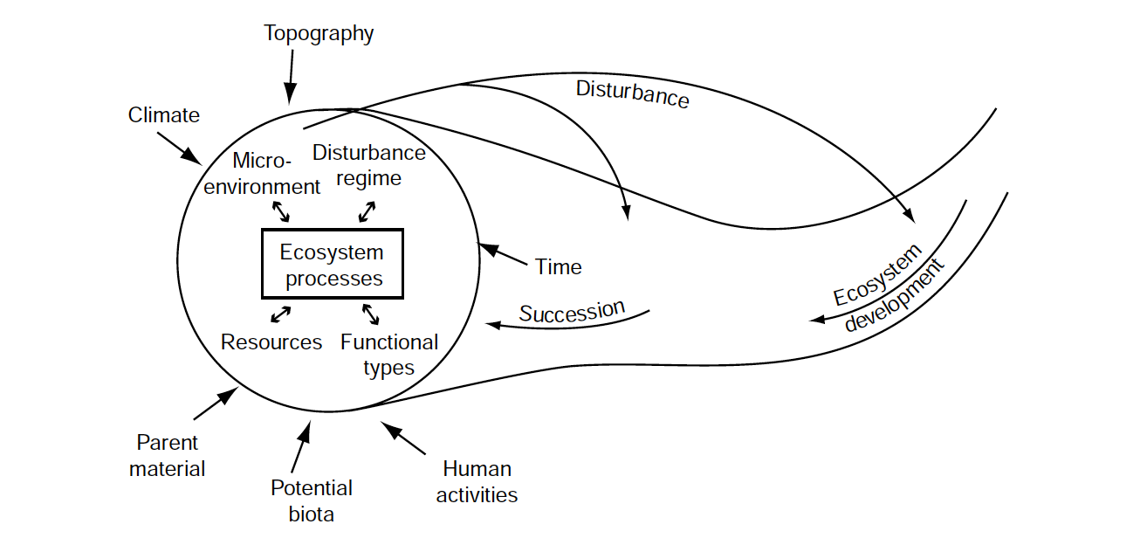
In your book, but modified from Chapin et al. (2006)

Slide 4
Temporal dynamics: Resilience

Slide 5
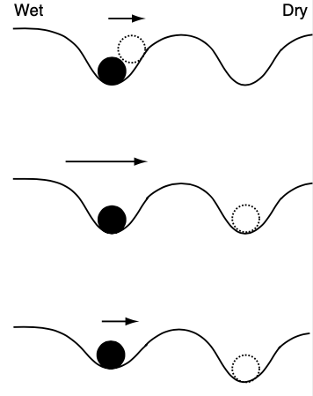
Depth of cup defines resilience of ecosystem
Length of arrow defines the strength of disturbance

Slide 6
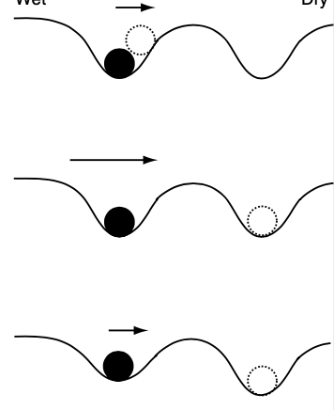
Resilient, weak disturbance
Resilient, strong disturbance
Not resilient, weak disturbance

Slide 7
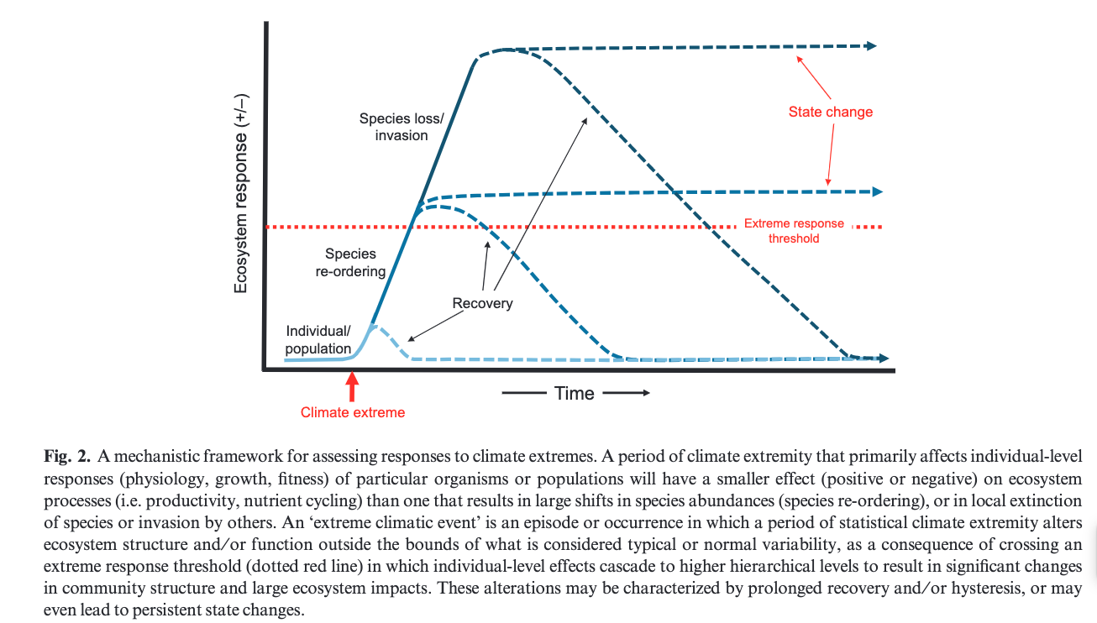
MD Smith (2011) J Ecology

Slide 8
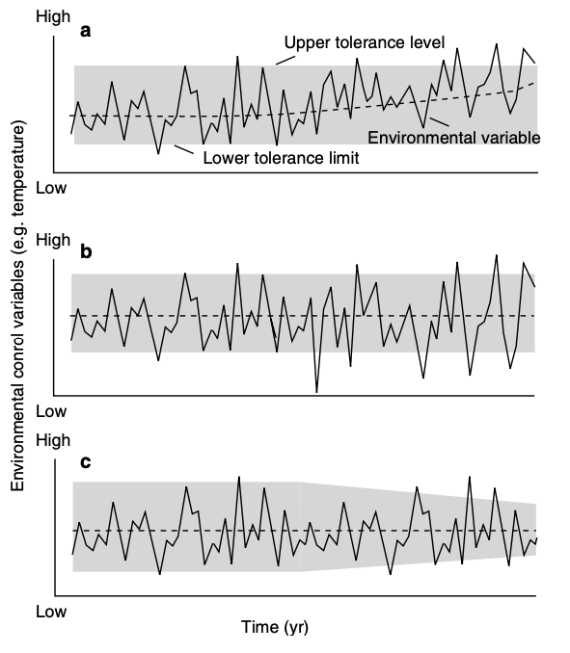
Range of resilience defines response
Directional shift in env. = more time outside range
More variable env. = more time outside range
Change in range = more time outside range

Slide 9
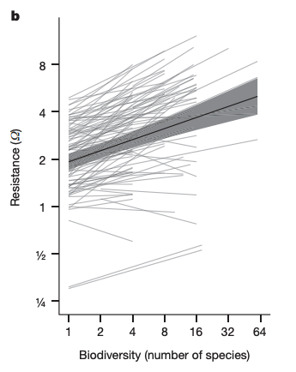
Ecological community defines response
Isbell et al. (2015) Nature

Slide 10
Temporal dynamics: History

Slide 11
It is important to understand the natural trajectory of a system to fully understand impact of a change

Slide 12
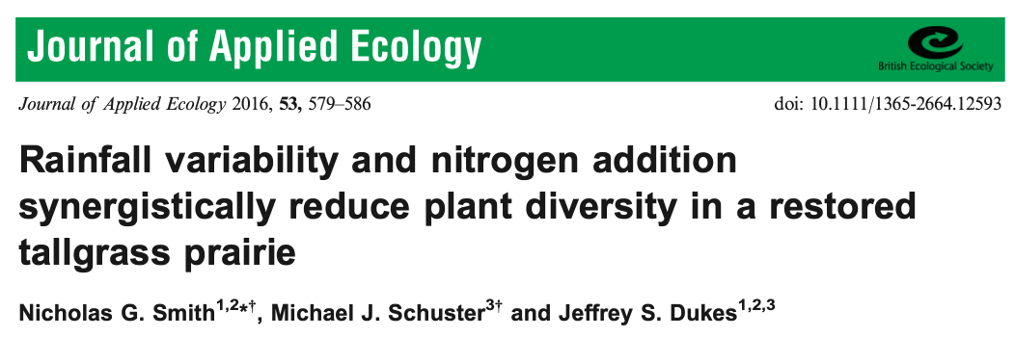
It is important to understand the natural trajectory of a system to fully understand impact of a change

Slide 13
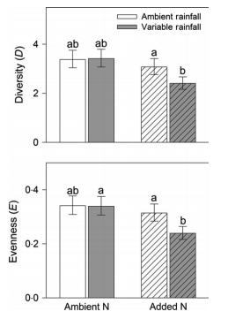
Smith et al. (2016) J Applied Ecology

Slide 14
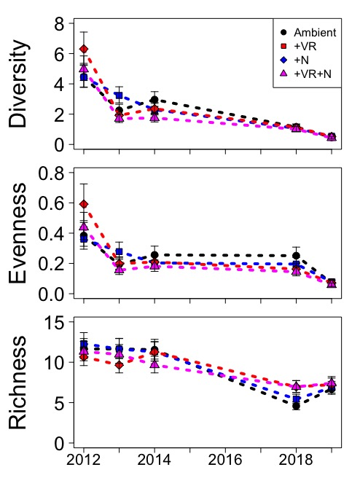
Treatments initially decreased diversity, but whole system was headed in that direction
Ploughe et al. (2021)

Slide 15
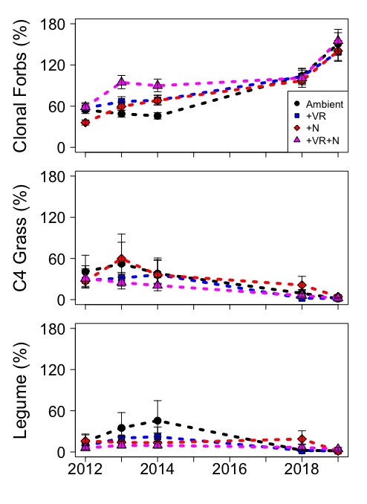
Treatments initially decreased diversity, but whole system was headed in that direction
Ploughe et al. (2021)

Slide 16
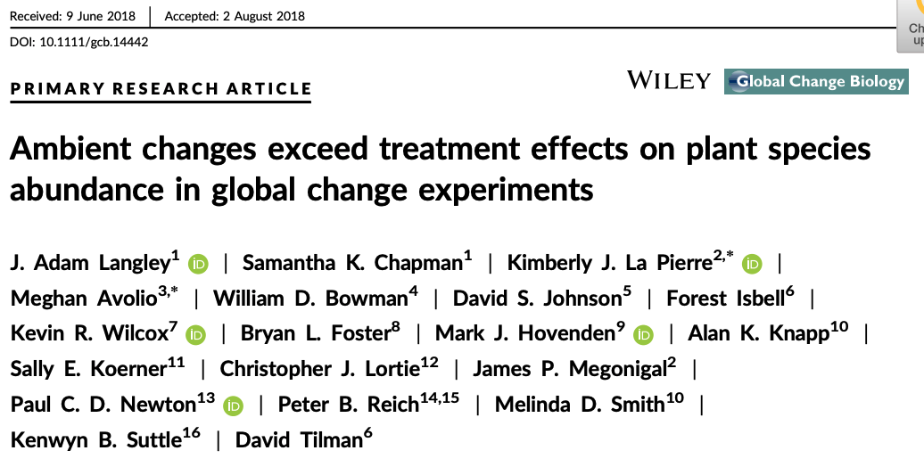

Slide 17
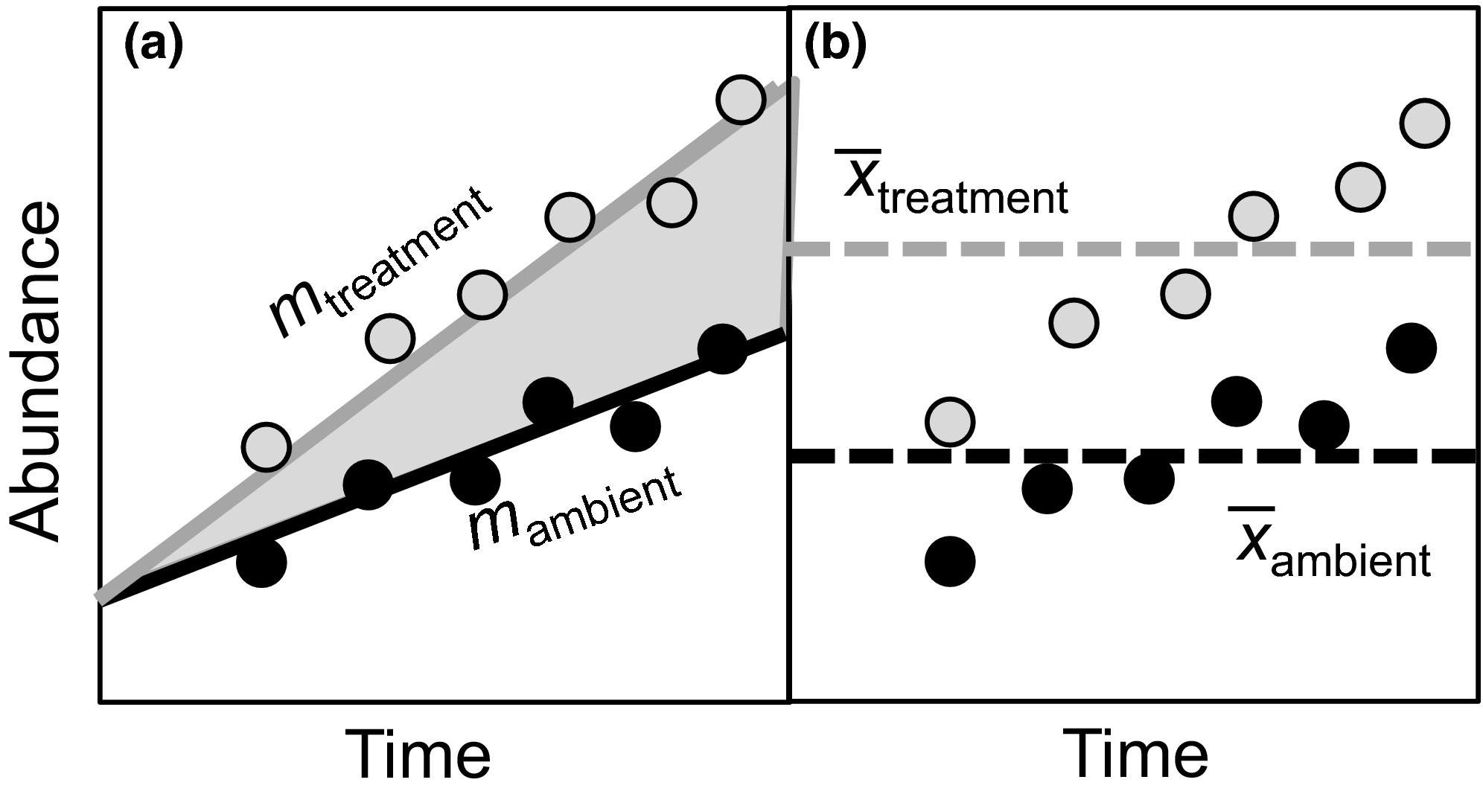
Ecosystems are always in flux
Langley et al. (2018)
Notes:
Legend: Stylized data illustrating estimation of treatment effects. The dynamic treatment effect (a) is the difference in linear trend attributable to the treatment, and the static treatment effect (b) is the difference in mean abundance over the course of the experiment. For clarity, symbols here represent treatment means, though individual plot data were used for the analyses

Slide 18
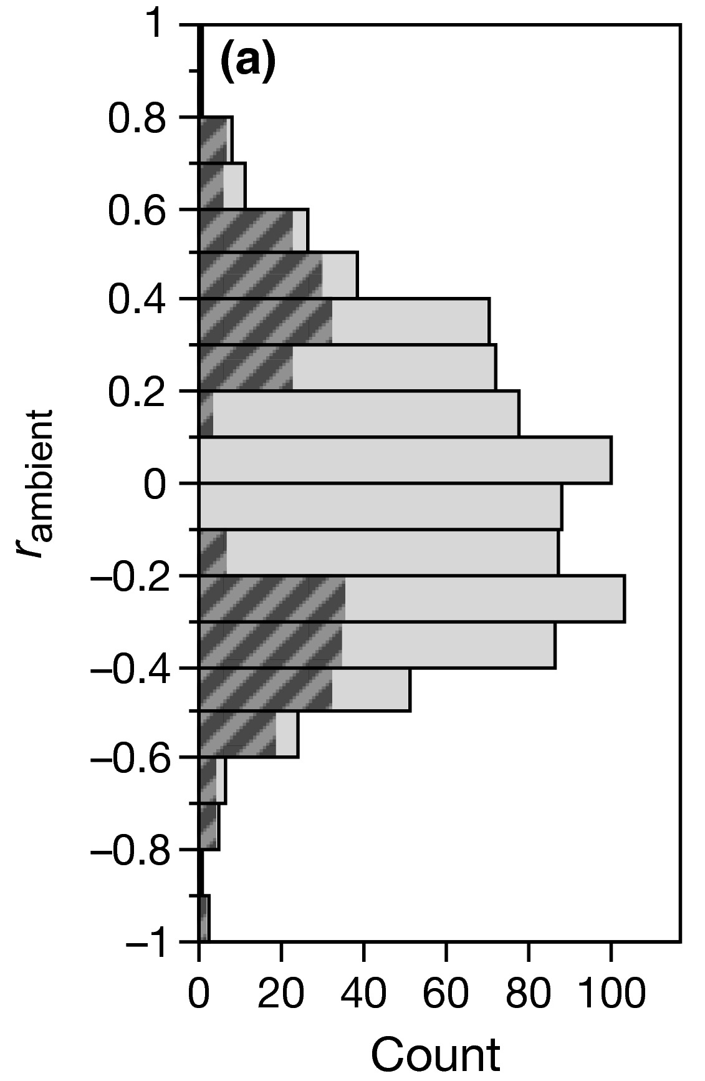
Ecosystems are always in flux
r_{ambient} = change in species composition over time in ambient plots
Langley et al. (2018)
Notes:
Distribution of long-term ambient changes in species abundance (r_{ambient} = correlation coefficient for species abundance vs. time). On the left (a), the full dataset is shown and hatched bars represent the site-species that exhibited consistent, directional change (slope p < 0.05 for correlations between abundance and year) under ambient conditions. On the right (b), the dataset is restricted to include only abundant species (>1% relative abundance), and hatched bars represent site-species that were exhibited highly consistent, directional change (p < 0.001)

Slide 19
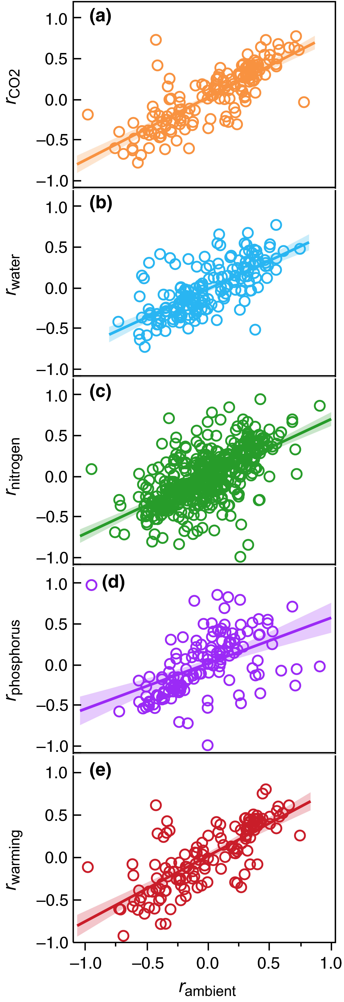
Natural fluctuations > response to treatments
Change under ambient conditions (x-axis) outpaces change in response to treatments (y-axis). That is, all slopes are <1.
Langley et al. (2018)
Notes:
Legend: Scatterplots of the relationship between r_{ambient} and r_{treatment} across all species separated by treatment. All p < 0.0001; (a) r_{CO2} = 0.773*r_{ambient} + 0.014; (b) r_{water} = 0.697*r_{ambient} − 0.026; (c) r_{nitrogen} = 0.703*r_{ambient} − 0.014; (d) r_{phosphorus} = 0.559*r_{ambient} + 0.004; (e) r_{warming} = 0.770*r_{ambient} + 0.007 r_{ambient} = the correlation coefficient of ambient plant abundance versus time r_{treatment} = the correlation coefficient of treatment plant abundance versus time

Slide 20
Temporal dynamics: Disturbance

Slide 21
Is disturbance bad for ecosystems?

Slide 22
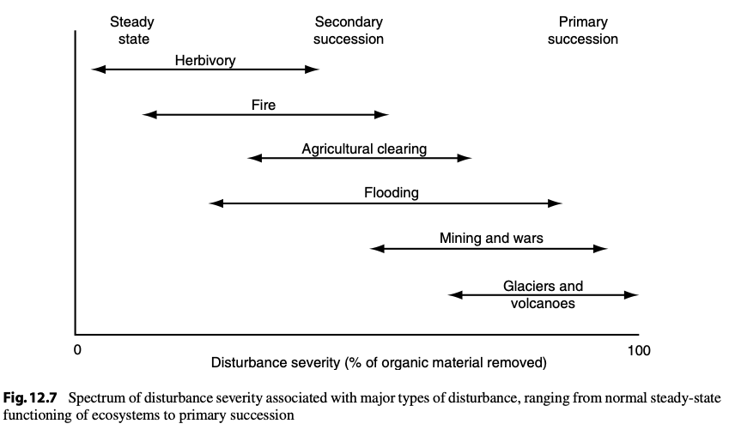

Slide 23
Types of succession
Primary
All organic matter is removed
Very little starting material
E.g., volcano, glacier
Secondary
Some organic matter remains
Some starting material
Happening all the time
E.g., fire, herbivory

Slide 24
An ecosystem’s disturbance regime
Type of disturbance
What happens?
Severity of disturbance
How much change does it cause?
Frequency of disturbance
How often does it happen?

Slide 25
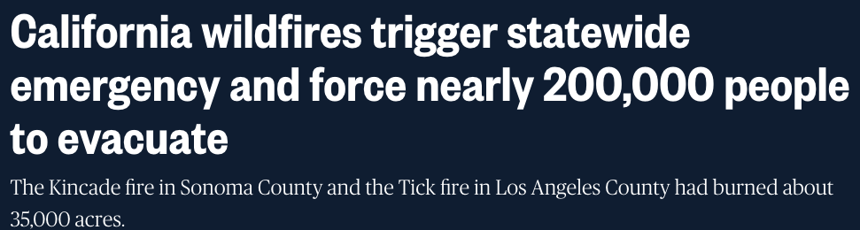
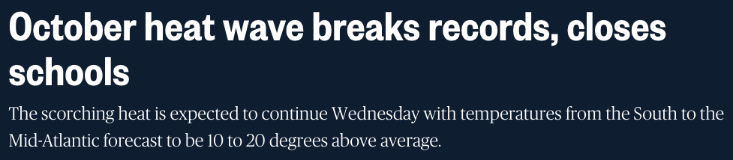
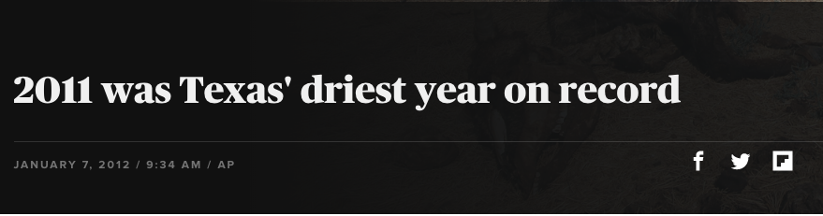
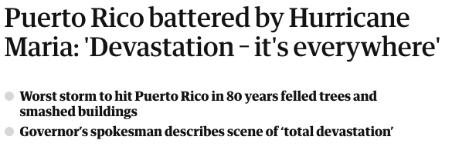
Global change is impacting disturbance regimes
NBC (10/02/19)
NBC (10/27/19)
AP/CBS
Guardian (09/21/17)

Slide 26
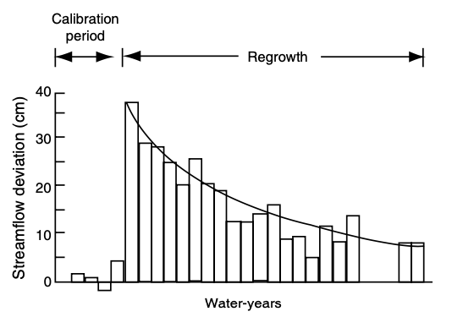
Ecosystem impacts of disturbance - water

Slide 27
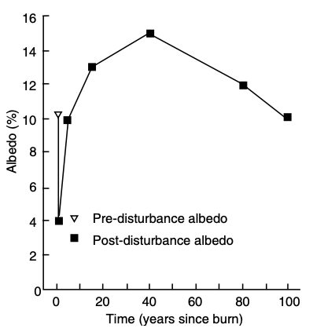
Ecosystem impacts of disturbance - energy

Slide 28
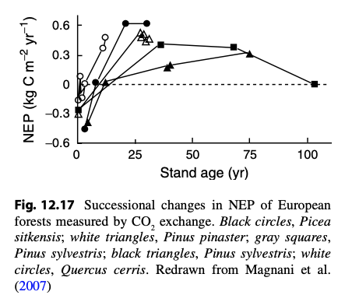
Ecosystem impacts of disturbance - carbon

Slide 29
Ecosystem impacts of disturbance - herbivory

Slide 30
Ecosystem impacts of disturbance - herbivory
Herbivory is highest during mid succession
Plant biomass is high
Plants investing in growth, not defense
Herbivores can enhance succession
Might not be good for them!
Herbivores
Early successional plants
Late successional plants
Modified from Paster et al. (1988) BioScience

Slide 31
Why is it important to consider the time scale of a study?

Slide 32
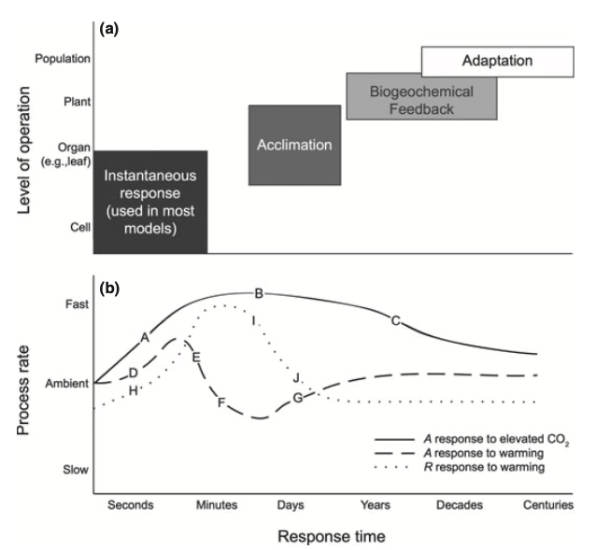
Smith and Dukes (2013)

